Slide 1
Department of Applied Mathematics and Computational Sciences
III Sem M.Sc.Software Systems
Transform Techniques
Dr. V. Suresh kumar

Slide 2
Continuous Wavelet Transform

Slide 3
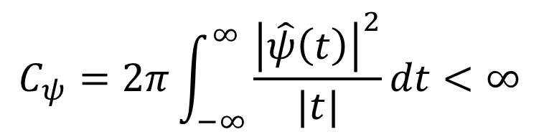

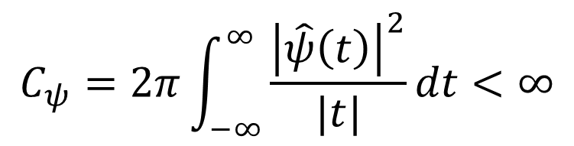
Definition
Suppose $ψ\left(t\right)$ is a finite energy function (Absolutely integrable function) that satisfies the condition
$$C_{ψ}=2π\int_{−∞}^{∞}{\frac{{\left|\hat{ψ}\left(t\right)\right|}^{2}}{|t|}dt}<∞$$
is called Wavelet.
$\hat{ψ}\left(t\right)$ is the Fourier Transform of the wavelet $ψ\left(t\right)$
Note:
The condition
$$C_{ψ}=2π\int_{−∞}^{∞}{\frac{{\left|\hat{ψ}\left(t\right)\right|}^{2}}{|t|}dt}<∞$$
is called admissibility condition.

Slide 4

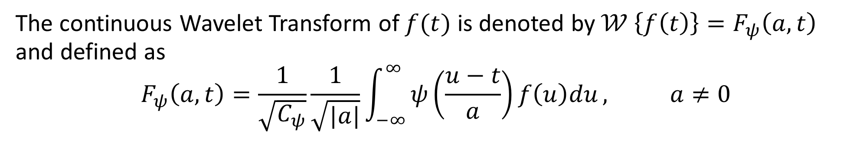
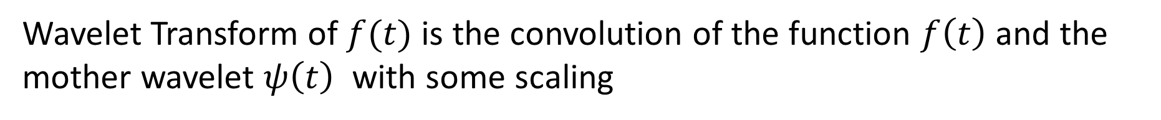
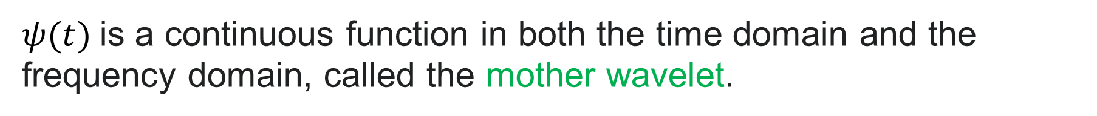
Definition
The continuous Wavelet Transform of $f(t)$ is denoted by$𝒲 \left\{f\left(t\right)\right\}=F_{ψ}\left(a,t\right)$ and defined as
$$F_{ψ}\left(a,t\right)=\frac{1}{\sqrt{C_{ψ}}}\frac{1}{\sqrt{|a|}}\int_{−∞}^{∞}{ψ\left(\frac{u−t}{a}\right)f\left(u\right)du}, a≠0$$
Where $a$ is a scaling factor and
$ψ(t)$is a continuous function in both the time domain and the frequency domain, called the mother wavelet.
Wavelet Transform of $f(t)$ is the convolution of the function $f\left(t\right)$ and the mother wavelet $ψ\left(t\right)$ with some scaling

Slide 5
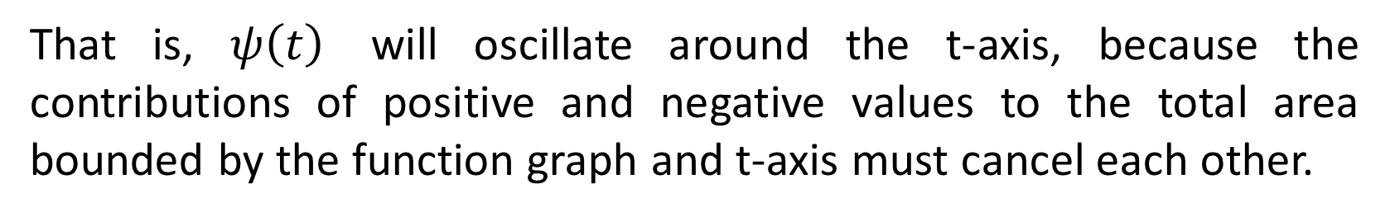
Note
If $\int_{−∞}^{∞}{ψ\left(t\right) dt}=0$ then $C_{ψ}<∞$.
That is, $ψ\left(t\right)$ will oscillate around the t-axis, because the contributions of positive and negative values to the total area bounded by the function graph and t-axis must cancel each other.
As $ψ\left(t\right)$ is finite energy, for $t→±∞,$ $ψ\left(t\right)$ is decreasing rapidly

Slide 6
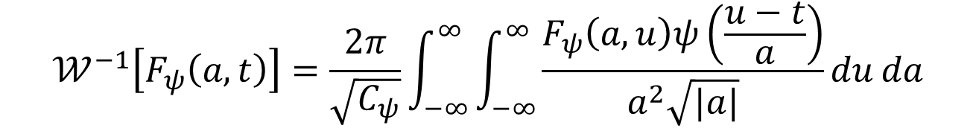
Inverse formula
$$𝒲^{−1}\left[F_{ψ}\left(a,t\right)\right]=\frac{2π}{\sqrt{C_{ψ}}}\int_{−∞}^{∞}{\int_{−∞}^{∞}{\frac{F_{ψ}\left(a,u\right)ψ\left(\frac{u−t}{a}\right)}{a^{2}\sqrt{|a|}}du}}da$$

Slide 7
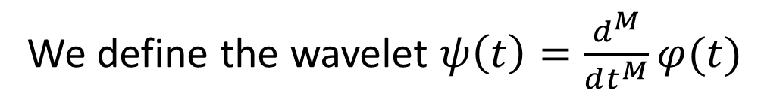
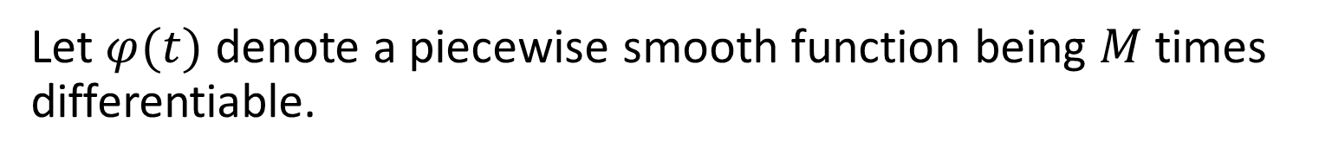
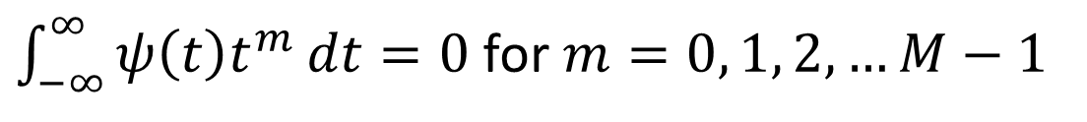
Construction principle
Let $φ(t)$ denote a piecewise smooth function being $M$ times differentiable.
We define the wavelet $ψ\left(t\right)=\frac{d^{M}}{dt^{M}}φ(t)$
(1)
$\int_{−∞}^{∞}{ψ\left(t\right)t^{m}}dt=0$ for $m=0, 1, 2, …M−1$
Higher order moments vanishes

Slide 8
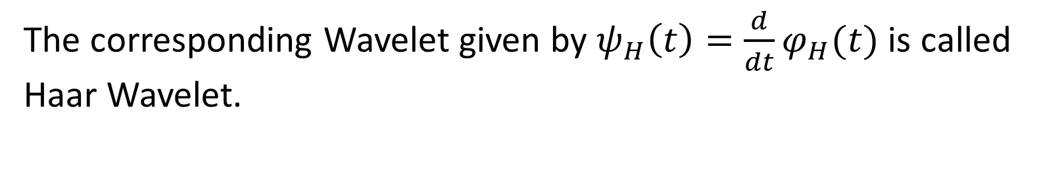
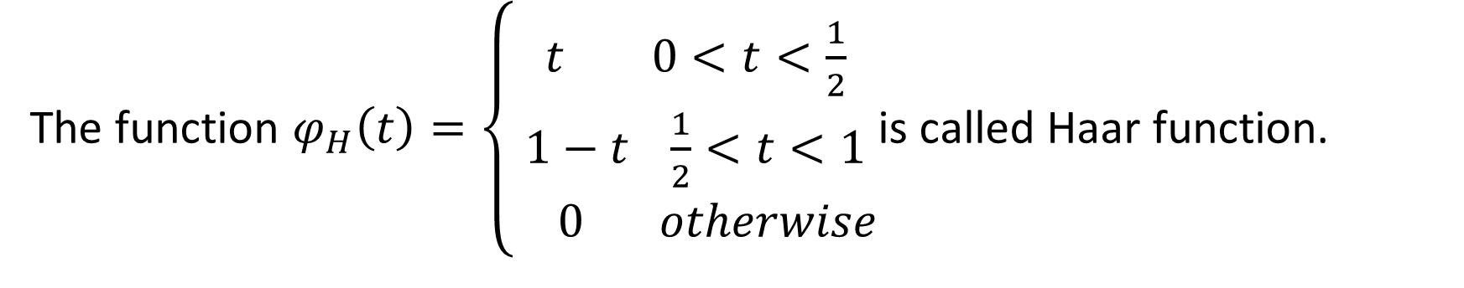
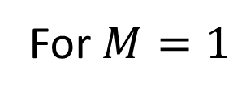
Haar Wavelet
The function $φ_{H}\left(t\right)=\left\{\begin{aligned}t 0<t<\frac{1}{2} \\ 1−t \frac{1}{2}<t<1 \\ 0 otherwise\end{aligned}\right.$is called Haar function.
The corresponding Wavelet given by $ψ_{H}\left(t\right)=\frac{d}{dt}φ_{H}(t)$ is called Haar Wavelet.
For $M=1$

Slide 9
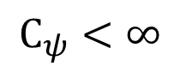
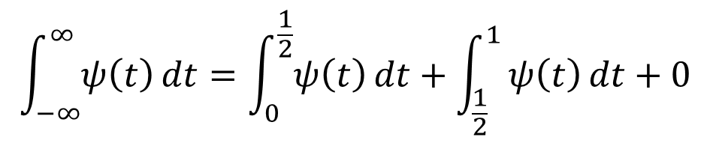
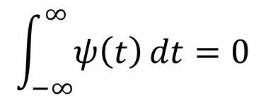
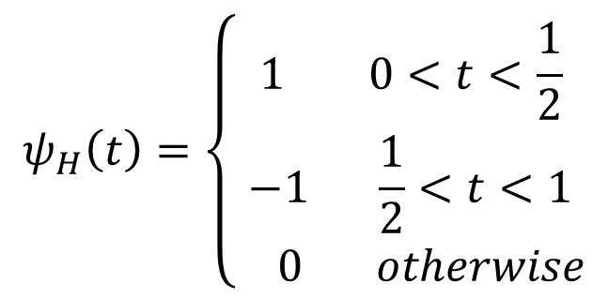
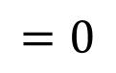
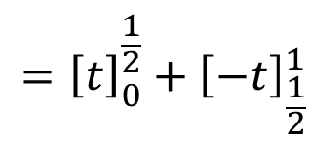
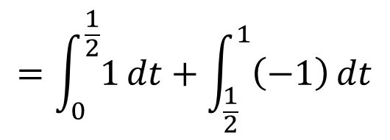
Haar Wavelet contd…
$$ψ_{H}\left(t\right)=\left\{\begin{aligned}1 0<t<\frac{1}{2} \\ −1 \frac{1}{2}<t<1 \\ 0 otherwise\end{aligned}\right.$$
$$\int_{−∞}^{∞}{ψ\left(t\right)}dt=\int_{0}^{\frac{1}{2}}{ψ\left(t\right)}dt+\int_{\frac{1}{2}}^{1}{ψ\left(t\right)}dt+0$$
$$\int_{−∞}^{∞}{ψ\left(t\right)}dt=0$$
$$=\int_{0}^{\frac{1}{2}}{1}dt+\int_{\frac{1}{2}}^{1}{\left(−1\right)}dt$$
$$C_{ψ}<∞$$
$$={\left[t\right]}_{0}^{\frac{1}{2}}+{\left[−t\right]}_{\frac{1}{2}}^{1}$$
$$=0$$

Slide 10
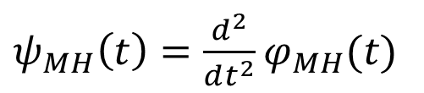
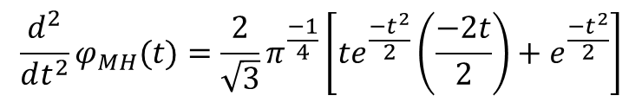
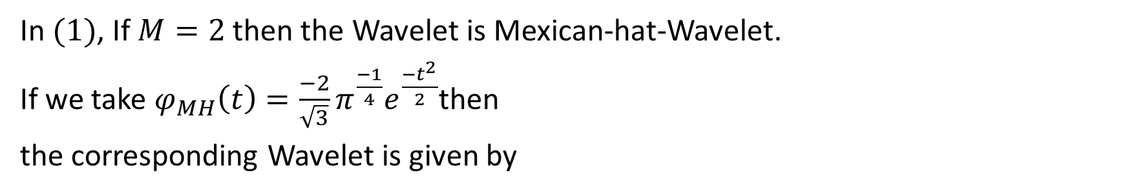
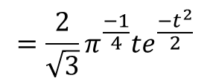
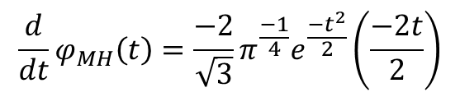
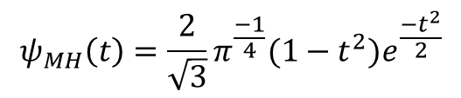
Mexican-hat-Wavelet
In $(1)$, If $M=2$ then the Wavelet is Mexican-hat-Wavelet.
If we take $φ_{MH}\left(t\right)=\frac{−2}{\sqrt{3}}π^{\frac{−1}{4}}e^{\frac{−t^{2}}{2}}$then
the corresponding Wavelet is given by
$ψ_{MH}\left(t\right)=\frac{d^{2}}{dt^{2}}φ_{MH}(t)$
$$\frac{d}{dt}φ_{MH}\left(t\right)=\frac{−2}{\sqrt{3}}π^{\frac{−1}{4}}e^{\frac{−t^{2}}{2}}\left(\frac{−2t}{2}\right)$$
$$=\frac{2}{\sqrt{3}}π^{\frac{−1}{4}}te^{\frac{−t^{2}}{2}}$$
$$\frac{d^{2}}{dt^{2}}φ_{MH}(t)=\frac{2}{\sqrt{3}}π^{\frac{−1}{4}}\left[te^{\frac{−t^{2}}{2}}\left(\frac{−2t}{2}\right)+e^{\frac{−t^{2}}{2}}\right]$$
$$ψ_{MH}\left(t\right)=\frac{2}{\sqrt{3}}π^{\frac{−1}{4}}(1−t^{2})e^{\frac{−t^{2}}{2}}$$

Slide 11
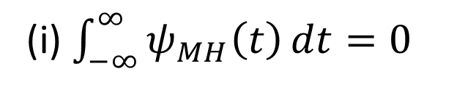
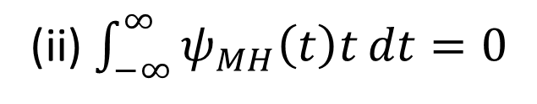
Moments Vanishes
In addition
(i) $\int_{−∞}^{∞}{ψ_{MH}\left(t\right)}dt=0$
(ii) $\int_{−∞}^{∞}{ψ_{MH}\left(t\right)t}dt=0$

Slide 12
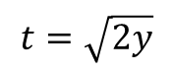
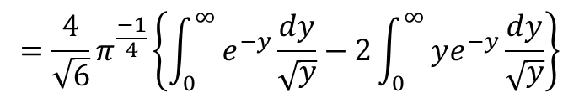
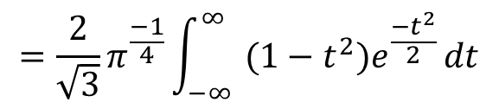
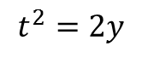
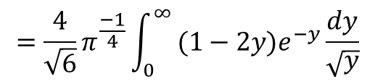
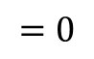
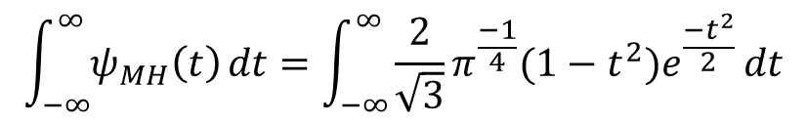
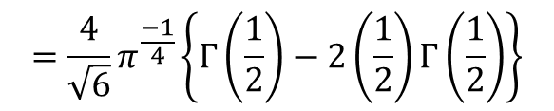
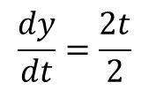
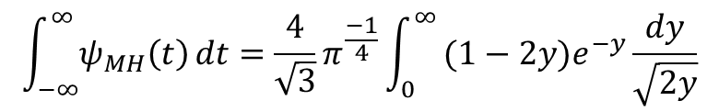
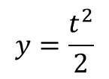
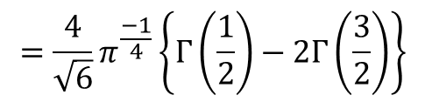
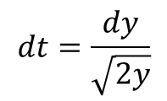
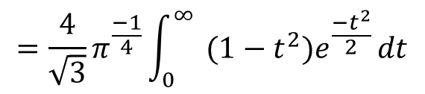
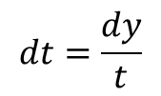
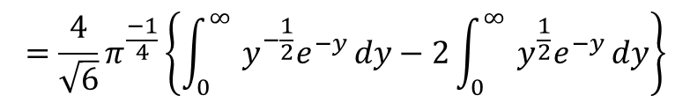
Justification
$$\int_{−∞}^{∞}{ψ_{MH}\left(t\right)}dt=\int_{−∞}^{∞}{\frac{2}{\sqrt{3}}π^{\frac{−1}{4}}(1−t^{2})e^{\frac{−t^{2}}{2}}}dt$$
$$\int_{−∞}^{∞}{ψ_{MH}\left(t\right)}dt=\frac{4}{\sqrt{3}}π^{\frac{−1}{4}}\int_{0}^{∞}{ (1−2y)e^{−y}}\frac{dy}{\sqrt{2y}}$$
(i)
$$=\frac{2}{\sqrt{3}}π^{\frac{−1}{4}}\int_{−∞}^{∞}{ (1−t^{2})e^{\frac{−t^{2}}{2}}}dt$$
$$=\frac{4}{\sqrt{6}}π^{\frac{−1}{4}}\int_{0}^{∞}{ (1−2y)e^{−y}}\frac{dy}{\sqrt{y}}$$
$$=\frac{4}{\sqrt{3}}π^{\frac{−1}{4}}\int_{0}^{∞}{ (1−t^{2})e^{\frac{−t^{2}}{2}}}dt$$
$$=\frac{4}{\sqrt{6}}π^{\frac{−1}{4}}\left\{\int_{0}^{∞}{ e^{−y}}\frac{dy}{\sqrt{y}}−2\int_{0}^{∞}{ ye^{−y}}\frac{dy}{\sqrt{y}}\right\}$$
$$y=\frac{t^{2}}{2}$$
$$t^{2}=2y$$
$$=\frac{4}{\sqrt{6}}π^{\frac{−1}{4}}\left\{\int_{0}^{∞}{ {y^{−\frac{1}{2}}e}^{−y}}dy−2\int_{0}^{∞}{ y^{\frac{1}{2}}e^{−y}}dy\right\}$$
$$\frac{dy}{dt}=\frac{2t}{2}$$
$$t=\sqrt{2y}$$
$$=\frac{4}{\sqrt{6}}π^{\frac{−1}{4}}\left\{Γ\left(\frac{1}{2}\right)−2Γ\left(\frac{3}{2}\right)\right\}$$
$$dt=\frac{dy}{t}$$
$$=\frac{4}{\sqrt{6}}π^{\frac{−1}{4}}\left\{Γ\left(\frac{1}{2}\right)−2\left(\frac{1}{2}\right)Γ\left(\frac{1}{2}\right)\right\}$$
$$dt=\frac{dy}{\sqrt{2y}}$$
$$=0$$

Slide 13
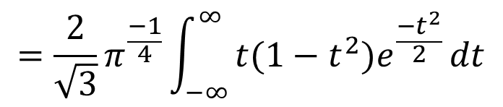
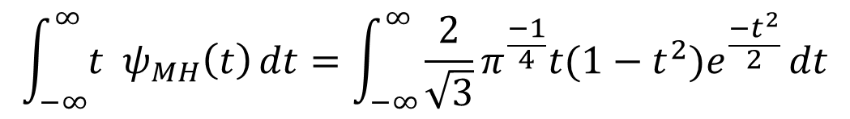
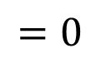
Justification contd…
$$\int_{−∞}^{∞}{{t ψ}_{MH}\left(t\right)}dt=\int_{−∞}^{∞}{\frac{2}{\sqrt{3}}π^{\frac{−1}{4}}t(1−t^{2})e^{\frac{−t^{2}}{2}}}dt$$
$$=\frac{2}{\sqrt{3}}π^{\frac{−1}{4}}\int_{−∞}^{∞}{t(1−t^{2})e^{\frac{−t^{2}}{2}}}dt$$
$$=0$$
Odd function

Slide 14
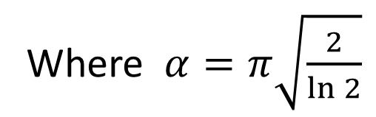
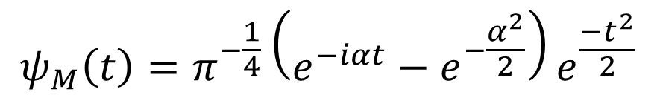
Morlet-Wavelet
This is the first Wavelet explored for signal analysis and it is a complex valued.
$$ψ_{M}\left(t\right)=π^{−\frac{1}{4}}\left(e^{−iαt}−e^{−\frac{α^{2}}{2}}\right)e^{\frac{−t^{2}}{2}}$$
Where $α=π\sqrt{\frac{2}{\ln{2}}}$
The corresponding Wavelet Transform is also complex valued function.

Slide 15

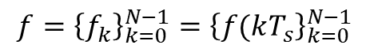

Discretization process
When numerical algorithms and applications enter the picture, we will not deal with continuous time signals.
We shall consider sequences obtained by sampling the continuous time signal $f(t)$ for $t=0, T_{s}, 2T_{s}, …, \left(N−1\right)T_{s}$.
Here $T_s$denotes the “sampling distance” and the sequence elements are denoted with
$f_{k}=f\left({kT}_{s}\right), k=0,1, …, N−1$
$$f={\left\{f_{k}\right\}}_{k=0}^{N−1}={\left\{f(kT_{s}\right\}}_{k=0}^{N−1}$$
The above process is called discretization process
$f$ may be represented as a row vector of $N$ real numbers

Slide 16



Algorithm for the computation
Define the sequences ${\left\{ψ_{a}(kT_{s})\right\}}_{k=0}^{N−1}$ and ${\left\{f(kT_{s})\right\}}_{k=0}^{N−1}$
Compute the DFT of the sequence ${\left\{ψ_{a}(kT_{s})\right\}}_{k=0}^{N−1}$ resulting a ${\left\{A_{k}\right\}}_{k=0}^{N−1}$
Also compute the DFT ${\left\{F_{k}\right\}}_{k=0}^{N−1}$ of ${\left\{f(kT_{s})\right\}}_{k=0}^{N−1}$
Apply IDFT to the product sequence $\frac{1}{\sqrt{C_{ψ}|a|}}{\left\{F_{k}A_{k}\right\}}_{k=0}^{N−1}$ so that
we get ${\left\{F_{ψ}\left(a,kT_{s}\right)\right\}}_{k=0}^{N−1}$
Because of convolution theorem
$$T\left\{f\left(t\right)∗g\left(t\right)\right\}=F\left(s\right)G(s)$$
$$T^{−1}\left[F\left(s\right)G\left(s\right)\right]=f\left(t\right)∗g(t)$$

Slide 17

Impact of scaling factor on wavelet transform
A (continuous) wavelet transform is given by the integral of the product between signal (s) and the kernel ((wavelet) w), where the kernel is both shifted and stretched, allowing to extract information at different scales.

Slide 18
Applications of the wavelet transform
One of the most popular applications of wavelet transform is image compression.
The advantage of using wavelet-based coding in image compression is that it provides significant improvements in picture quality at higher compression ratios over conventional techniques.
Since wavelet transform has the ability to decompose complex information and patterns into elementary forms, it is commonly used in acoustics processing and pattern recognition.
wavelet transforms can be applied to the scientific research on edge and corner detection, partial differential equation solving, transient detection, filter design, electrocardiogram (ECG) analysis, texture analysis, business information analysis and gait analysis

Slide 19


